Slide 1



Psychosocial hazards at work
Lachlan O’Neill: Principal Inspector, Psychological Health & Safety
11 October 2023
Notes:
Thank you Simone / Stewart /
Good morning everyone – I’m thrilled to be here to talk you about workplace health and safety, and a number of very specific hazards and risks in the government sectors

Slide 2
What are we covering?
Workplace mental health snapshot
Psychosocial hazards in the workplace
Legislative framework
Regulation amendments
Code of Practice
Resources
Notes:
Over the next ____ hour or so I’ll talk about mental health at work, the impact psych injuries have on workers but also on our broader workplaces
The WHS legislation, as it relates to psychological health and safety.
There’ve been some changes to WHS laws and there’s the Code of Practice for psych hazards at work.
We’re going to talk about the common causes of poor mental health and of these, particularly workplace bullying.
There’s 10 case studies within the Code of Practice – I’ll show you one of these, which is industry specific.
I’ll talk about WHS rights – what we can do, and some protections for workers and HSRs
I’ll talk about a free, digitally available, evidence based, psychosocial audit tool which can easily be used to identify, assess and control risks to psychological health at work
Resources – where you can find further information to help you
- and then hopefully we’ll have some time for Q&A

Slide 3




Impact of workplace mental health
$3.9 billion
per year
estimated cost to NSW of mental-ill health at work¹
More than
8,200 people
claimed compensation from work related
psychological injuries in FY 2020-21⁴
Nearly 1 in 4 workers believe they have a mental health condition that their workplace caused or made worse²
In the five years to June 2021,
psychological claims rose 65%
and physical injury claims were steady³
Notes:
Some of the stats.
In NSW, in the 5 years to June 2021, there was a 65% increase in the number of claims for psych injury, while claims for physical injuries were steady.
What’s not on the screen is that in terms of the impact just one work related psych injury has - on a worker (and the workplace), that IW will average a total of around 225 work days lost.
That’s pretty much all of the work days in a year for a full timer.
The claims cost of one psych injury averages around $100,000 now. Let alone costs for recruiting, training, supervising new staff, disputes, investigation and legal costs, and losses to productivity.
Claims data tells us the main causes are workplace bullying and harassment (35% of all psych claims) and work pressure (at 28%).
So, overall performance wise – it’s sobering. Not a pretty picture.
References:
1. AIHW, 2020, People with disability in Australia 2020:in brief
2. SuperFriend, National Report 2021
3. SIRA Psychological Workers Compensation data 2015/2016 - 2020/21
4. SIRA Psychological Workers Compensation data 2020/21

Slide 4

Psychosocial hazards are anything that increases the risk of work-related stress
Role overload (high workloads or job demands)
Exposure to traumatic events
Role conflict or lack of role clarity
Job control
Conflict or poor workplace relationships
Support from supervisors and managers
Co-worker support
Role underload (low workloads or job demands)
Workplace violence
Bullying
Harassment including sexual harassment
Reward and recognition
Hazardous physical working environments
Remote or isolated work
Procedural justice (processes for making decisions)
Organisational change consultation
Notes:
And what causes it?
There is now a legal definition for psychosocial hazards, but broadly it is anything in the design or management of work that causes stress.
Stress is the physical, mental and emotional reaction a person has when they feel the demands of their work exceed their ability or resources to cope. Stress itself is not an injury, and we all get exposed to it.
Work-related stress if prolonged or severe can cause both psychological and physical injury.
Listed on this slide are the risk factors (or the psych hazards) which have been identified through research to be those in workplaces which are most likely to cause psychological injury, although they can cause physical injury too.
Just so you know, you can find this list, with more detail, on pages 7 and 8 of the Code of Practice.
I’ll just touch on a few of these: excessive workload is a common psychosocial hazard. Exposure to traumatic events. Bullying, violence and harassment, including sexual harassment are all behaviours which can contribute to stress. A lack of role clarity – who is responsible for what. Any of these can lead to conflict. Quite often people are unable to properly describe what they’ve experienced in terms of these factors and simply lump it all under the catchphrase ‘bullying’.
If that happens – I suggest it’s an opportunity to consider whether other risk factors may be the underlying cause for conflict and or stress.
The most well-known way of thinking about these psychosocial hazards is the job demands/job control model.
In that model, basically, the worker’s experience of the demands that they face is balanced against the resources they have and the control necessary to meet those demands… this is what influences the risk.
So, the more frequently, and the longer and more severely a person is exposed to a risk factor, and the more risk factors that a person is exposed to, the higher the risk, and the more stress is put on a person. We are all exposed to stress, but its really when we feel unable to cope that people suffer workplace psychological injury.
So the red factors on the slide are the demands, or the factors you want to minimise, and the green factors are the resources, which really need to be maximised.
The message I’d like you to understand from this slide, is that to properly raise or address work related stress factors, it’s helpful to be able to describe the problem clearly.

Slide 5
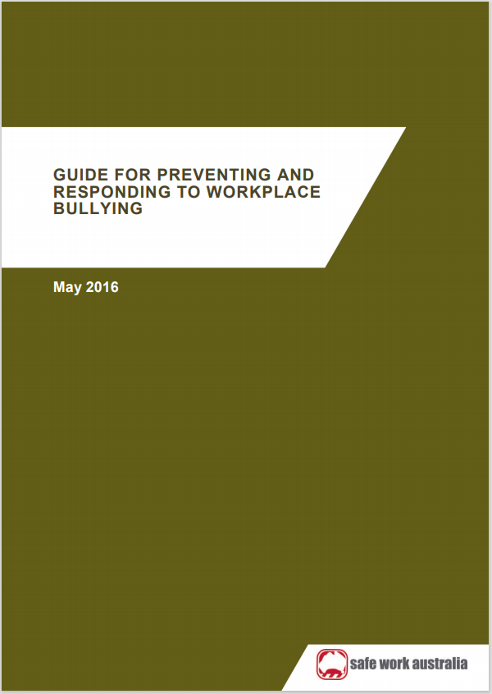
Workplace bullying
My experience
Not usually about ‘psychopaths’!
Intentions often misunderstood
Commonly about power
Experience: Can be any direction
more often than not, downwards
Tips
Treat reports/injuries as opportunities NOT complaints to defend against.
Investigations: not always necessary, can make things worse, but when serious or requiring disciplinary action, vital. Record decision making!
When possible: quick and informal resolution, restore relationships.
Procedures: quick, cost effective, as non-intrusive as possible, fair.
If treat purely as disciplinary issue may fail to manage underlying risk factors. Bonus: addressing factors often doesn’t allocate blame!
Involve WHS management, consult, record decision making!
Ensure you address the underlying psychological risk factors (earlier psychological hazards slides).
Consider that people under stress don’t always react reasonably and/or can perform badly.
Notes:
So, bullying! I’m sure you’ve all heard the definition.
Repeated, unreasonable behaviour directed towards a worker or group of workers that creates a risk to health and safety.
Government departments generally have systems to manage this: policies and procedures, codes of conduct, investigation procedures. Doesn’t mean the policies or procedures are always perfect or that they’re used.
I guess I want to talk about a few things.
Firstly, bullying in the workplace is very rarely anything to do with workplace psychopaths. I mean, they exist, but in most cases, the interactions and run ins in the workplace which are often called bullying, are conflict arising from other factors, often in combination: excessive workload, management styles and associated power imbalances, differences in expectations, a lack of role clarity, poorly managed or unfair performance management, perceptions of nepotism or bias in the allocation of work or in promotions, a lack of recognition and reward, or failure to provide support when it’s needed, things like that.

Slide 6

NSW WHS Legislative Framework
WHS Act
WHS Regulation
Codes of Practice
Guidance material
Duty holders must follow
Explains and clarifies:
common psychosocial hazards at work
legal duties and provides examples on what compliance looks like when these duties are met
who has a role to manage psychosocial hazards at work
what is involved in managing psychosocial hazards at work
safework.nsw.gov.au/legal-obligations/legislation
Notes:
The primary purpose of the WHS framework is to require safe and healthy work environments and safe work systems. It is based on the principle that work-related risk must be eliminated or if that’s not practicable, it must be minimised so far as is reasonably practicable. ​
​
Act​
The Act is broad and covers all work situations and must be followed. It defines health as physical and psychological. It provides a legal framework to protect the physical and psychological health, safety and welfare of all workers and others in relation to NSW workplaces and work activities. ​
​
The PCBU has a primary duty to ensure, so far as is reasonably practicable, the health and safety of workers and also to ensure that other persons are not put at risk from work carried out arising from the business or undertaking. This includes managing the risks of psychosocial hazards at work to ensure they are eliminated or minimised. ​
There is also a duty for the business or undertaking to consult, so far as is reasonably practicable, with all workers who carry out work for the business or undertaking and who are likely to be directly affected by a health and safety matter and this includes the identification and management of psychosocial hazards at work​
​
WHS Regulations​
In the past, psychosocial hazards weren’t written into the WHS Regulations. In October last year 4 new clauses all dealing with psychosocial hazards and risks were inserted in the Work Health and Safety Regulation 2017.
Codes of Practice​
Since May of 2021, NSW now has a Code of Practice, called Managing psychosocial hazards at work.
​It’s on our website. Picture on RHS of screen.
It explains the duties for duty holders in NSW
what compliance looks like for psych health and safety.
It can help you to describe psych hazards present in your workplace, how to identify them, and managing risks as close as possible to the source of the hazard. Similar to physical hazards and risks – we deal with the length and frequency of exposure, potential severity.
There are 10 different industry based scenarios with example control measures.
There’s an example risk register
​
Guidance material​
Guides are typically short and hazard specific and are able to suggest options that go beyond the minimum safety requirements and legal duties, for example advocating interventions to support workers’ general mental health and wellbeing. ​We have the national guide Work-related psychological health and safety: A systematic approach to meeting your duties

Slide 7
WHS Reg psychosocial changes (summarised!) from 1 October 2022
Clause 55A: Meaning of psychosocial hazard
(a) arises from, or relates to—
(i) the design or management of work, or
(ii) a work environment, or
(iii) plant at a workplace, or
(iv) workplace interactions or behaviours, and
(b) may cause psychological harm, whether or not it may also cause physical harm
Clause 55B: Meaning of psychosocial risk
A risk to health and safety of a worker or other person arising from a psychosocial hazard
Clause 55C: PCBU duty to manage psychosocial risks
… in accordance with Part 3.1 other than clause 36
Notes:
So on the screen I’ve put up a summarised version of the psychosocial additions to the WHS Regulation 2017 for NSW
55A sets out a definition of psychosocial hazards – we’ve never had that before
55B defines psychosocial risks to health and safety directly arising from psychosocial hazards
55C says that PCBUs must manage psychosocial risks in accordance with Part 3.1 of the Reg other than clause 36.
What does that mean?
Well, Part 3.1 now applies in relation to psychosocial hazards and risks - requires identification of hazards, elimination of hazards or minimising the risks, the hierarchy of controls, maintenance of controls, and review and if needs be, revision of controls.
For psych hazards, these all apply, excepting for clause 36 – the clause on the hierarchy of controls. This clause is not a legal requirement for psychosocial hazards, because the hierarchy is structured towards handling physical hazards – although the basic principle still applies; risks from psychosocial hazards should be dealt with as close as possible to the source.

Slide 8

Clause 55D:
(1) A PCBU must implement control measures—
(a) to eliminate
(b) to minimise
(2) must have regard to all relevant matters, including—
(a) duration, frequency and severity of exposure
(b) how the psychosocial hazards may interact or combine
(c) the design of work - job demands and tasks,
(d) the systems of work - how work is managed, organised and supported,
(e) the design and layout, and environmental conditions, of the workplace,
(f) of workers’ accommodation,
(g) the plant, substances and structures at the workplace,
(h) workplace interactions or behaviours, and
(i) the information, training, instruction and supervision provided to workers.
Notes:
I note that this is paraphrased wording – not complete.
Again – this is primarily aimed at having businesses or employers out there take a proactive, preventative approach. To design work, and systems of work, and conditions at work, and to implement and maintain all of that in such a way that psychosocial hazards are eliminated if practicable, and if not, then the risk needs to be minimised, SFAIRP.
These clauses that I’ve talked about are the new ones, in the Regulation, which took effect from 1 October 2022 – but you’ll notice that the picture on the RHS is the front cover of the COP.
I’ve put that there because the COP tells us practicable ways of achieving all of this.

Slide 9
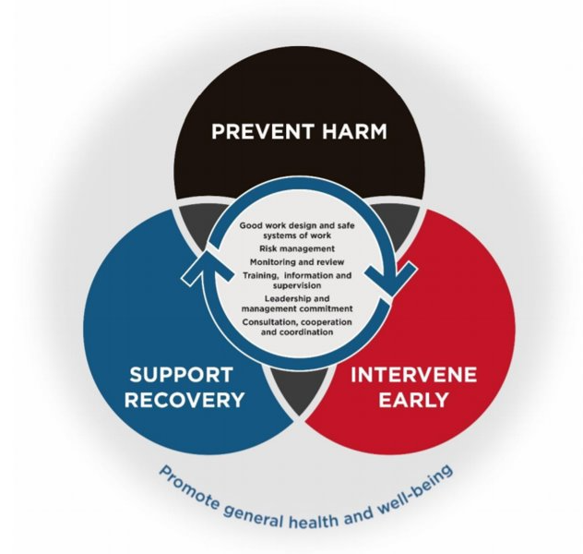
What is a mentally healthy workplace?
takes action
continually promotes good mental health,
manages risks to mental health through safe work practices and a positive work culture
supports early help seeking and recovery
Notes:
So the code of practice is designed to show industry, workers and unions - what is a mentally healthy workplace?
Picture on RHS shows the main pillars A mentally healthy workplace is one where both business leaders and their workers promote the importance of mental wellbeing and healthy practices, proactively and systematically prevent harm by identifying psychological hazards, act early when risks or harm occur, and support recovery from ill mental health. Work is designed to be safe and a positive workplace culture exists where workers feel valued and engaged.
It’s a workplace where people look forward to attending, are open to individuals' needs, and where employees and managers are flexible and supportive of each other.
If I had to talk about where the most gaps are in these pillars – it’s in harm prevention, being proactive.
One of the problems in dealing with workplace bullying that SafeWork as the WHS Regulator has, and to a degree the PSA will have as the employee association or Union, is that we often only find out about psychosocial hazards – bullying - conflict - relationship damage and injuries that result, when everything has already gone downhill, and exploded. At that point, it can be hard to sort out. Factions have developed, there might be trust issues, behaviours on both sides can get worse.
Have any of you seen situations like this in your workplace?
It’s challenging to deal with… for everyone. Managers, workers, their colleagues, the union, the regulator… it’s not impossible, but it’s hard.
I’m not telling you this to say it’s all too hard, it’s not. We can still make a difference. We can help identify the underlying causes or risk factors, and hopefully get these addressed. We can try and shift the focus to controlling risk and mending relationships rather than just taking sides and the fight.
But the biggest and most important way to make a difference is to help stop situations escalating to the point of explosion – which means getting in early.
Who do you think is best placed to do this?

Slide 10
WHS rights, safety issues and unfair treatment:
Say no to unsafe work
Notify / report issues, injuries, illnesses
WHS issue resolution process
Speak with: Manager(s), HSR, Union, SafeWork NSW
Phone 131050 for SafeWork NSW
SpeakUp App to report
Lodge a workers compensation claim (employer) for work-related injury or illness
Protections from discriminatory, misleading or coercive conduct
Anti-discrimination rights and protections
https://www.nsw.gov.au/mental-health-at-work/legal-obligations-and-rights#workers-legal-obligations-and-rights
Notes:
In your various workplaces, everyone has work health and safety right, and everyone should understand these.
And first of those is that whilst an employer, a supervisor can expect a worker to follow all reasonable and lawful directions - putting a worker at risk of injury is not reasonable. So if a worker feels that a particular task puts them at a real risk of injury, then they are within their rights to say no to doing that. Now, they shouldn’t just stop there… they need to speak with their supervisor to raise their concerns, and to let them know what they can do and what they won’t do. They should be asked to sort out the risk.
And this is where a work health and safety issue resolution process comes in. It’s a process you can follow to raise and request resolution of health and safety issues you identify at work.
Now, hopefully you’ve seen one for your workplace, and if you haven’t, please ask. It’s a legal requirement that it be there.
People who can assist workers through such a process can include management, health and safety representatives like yourselves, you can assist, your union may be able to assist, whether that ‘s a delegate or a union official, or if you’ve tried to resolve safety issues and it’s just not happening, you may want to request assistance from SafeWork NSW. Thirteen Ten Fifty is our phone number. Or you can use the SpeakUp app - to report.
If you suffer a work-related injury or illness lodge a claim with your employer.
Also, being able to raise workplace health and safety issues is a right under WHS law. And trained HSR’s have particular rights under WHS law – consult with workers on matters affecting their WHS, to raise WHS issues, including psychosocial hazards and risks, or to serve PINs. It’s illegal to victimise someone because they have exercised a WHS right. And it’s illegal to coerce someone not to exercise their WHS rights. Please speak up if this occurs – your Union or SafeWork NSW can get involved in addressing instances of such inappropriate action.
If you feel you’re being bullied or have been exposed to violence, bullying, harassment or sexual harassment at work, we have advice on what you can do on the SafeWork website.
There are numerous protections for workers against discrimination because of particular attributes, such as disability, mental illness, racial background, gender, religious beliefs, union membership, etc. Sometimes these are agencies other than SafeWork NSW which are better placed to help sort these out, so I won’t go into details about these other than to suggest that if you feel it’s happening to you, then you should probably speak to someone about that, get advice – the Union, the antidiscrimination board (ADB), the NSW IR Commission, a lawyer.
You can get more info on all of these at the web address at the bottom of this slide.

Slide 11
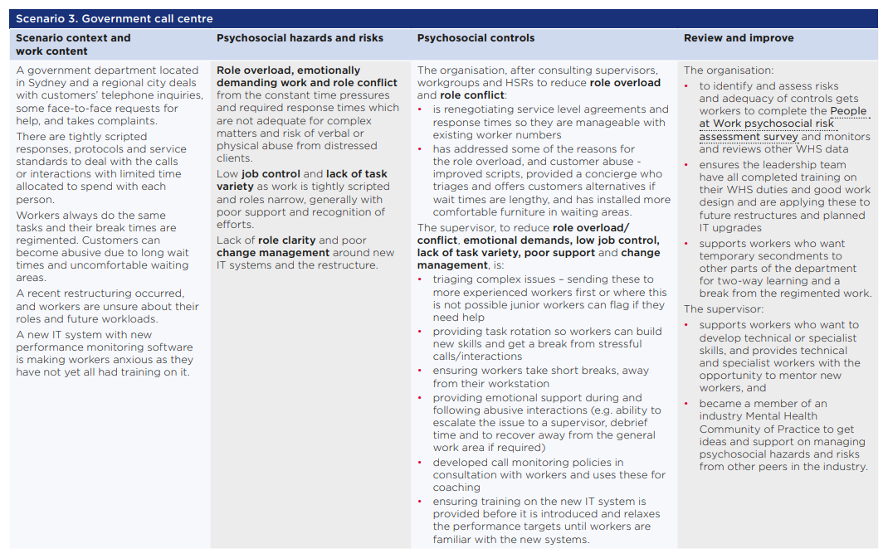
Scenario 1 – Health Care
Notes:
The code of practice has 10 scenarios for all sorts of different industries. Construction, manufacturing, transport, retail, call centres, hospitals, and more.
It really is about breaking it down as practical examples for businesses or organisations to understand ‘How can the code of practice be used?’
This is what a scenario looks like, but because it’s on a screen, and hard to read…

Slide 12





CASE STUDY: Government Call Centre
Hazards & Risks
Role overload, role conflict, abuse from clients, low job control, lack of task variety, lack of role clarity, poor change management
Controls
Workload: address or prioritise demands, adequate resources or efficiencies. Training, escalation processes. Rotation of tasks. Role descriptions, responsibilities defined. Debriefs. Consultation, etc.
Review and Improve
Conduct regular work reviews. Review period for controls in consultation with workers. People at Work Psychosocial Audit Tool.
Notes:
I’ve done an easier to read version for you
One of these scenarios is a government call centre dealing with client enquiries both in person and on the phone. It’s just an example – and there are 9 others. I won’t go into much detail except to say that it looks at some of the common hazards (role overload, a lack of role clarity, etc) and associated risks, gives examples of how measures can be implemented to control these risks, as well as ensuring that processes to review how well WHS is going, and to continually try and improve on this.
You can read more on this in the scenarios within the Code of Practice – and there are multiple examples for different industries, but with transferrable ideas on how to manage common hazards and risks.

Slide 13
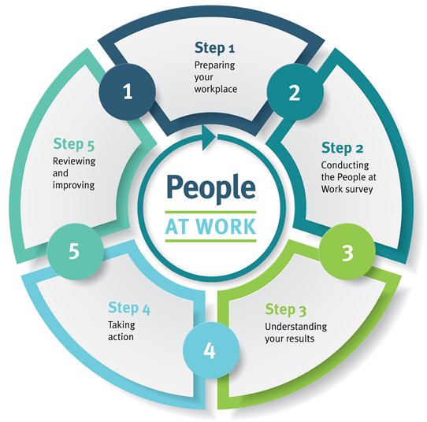
People at Work
Australia’s free validated and evidence-based psychosocial risk assessment survey tool with benchmarking.
A five step process to identify, assess and control risks
to psychological health at work.
Suitable for businesses with more than 20 workers.
peopleatwork.gov.au
Nationally available via a digital platform consisting of resources, interactive learning modules and automated custom reports
– all for free.
Notes:
Lachlan
We have been talking about the Code of Practice, which specifies common psychosocial hazards and the risk management process.
Now we will talk about People at Work, a psychosocial risk management tool developed from Australian research, and measuring the hazards specified in the code.
People at Work, is more than just a survey – it’s a suite of resources that help businesses manage the risk of these psychosocial hazards and meet their work health and safety obligations
Australian regulators have worked together to turn this tool into a self-administered digital tool, available at peopleatwork.gov.au
The idea is that businesses don’t have to spend money on consultants, there is enough information and resources on this website to guide a business through the risk management process
People at Work has a 5 step process which includes preparing the workplace, conducting the survey, understanding the results, taking action and reviewing & improving
At the heart of the process is the People at Work survey tool
The survey is suitable for businesses with more than 20 workers and the survey takes approximately 10-15 minutes per worker to complete.
Once the survey is completed by the business the website automatically generates a report for the business.
The survey the workers complete is anonymous, the workplace will not have access to individual responses, only an aggregated report with a minimum of 20 responses.
You can also break the results down into workgroups within the broader business. Each workgroup needs at least 10 responses for those results to be included in your report (for anonymity reasons). So for example, you could have a workplace with multiple teams across different locations, provided there are at least 10 workers in each team completing the survey, then those results will be included in the report.
There are a range of tools available to help a business implement People at Work, including a comms plan, promo posters, FAQs, project timeline, sample reports, action planning guide and control measures.

Slide 14
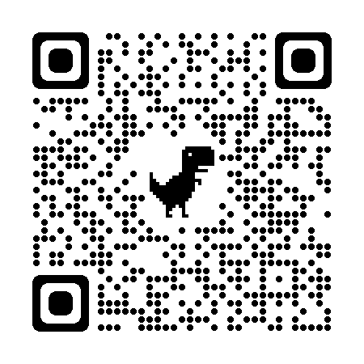
Find out more:
Lachlan O’Neill
Principal Inspector
Specialist Operations – Psychological WHS
Health and Safe Design
SafeWork NSW
T 131050
Notes:
At SafeWork NSW we have a range of services and resources on our website that can help you create a mentally healthy workplace.
I don’t want to give you all publications to take away – most people don’t read them.
Instead – we have a webpage where you can access most of these.
Since the pandemic, we all know how to use QR codes
If I can encourage you to access that on your phones now. Once you get in, please bookmark the page.
Relevant legislation
The code of practice
Resources including the People at Work psychosocial risk assessment tool
Some guidance material.
Hopefully now we have some time for a Q&A, and I will stick around for a little while after the presentation, so if there are individual questions, please feel free to ask then.

