Slide 1
Beating Burnout

Slide 2
Acknowledgment of Country
© This material remains the property of HSE Global

Slide 3
Presented by
Emma Boucher
Senior Psychologist
Mental Health and Wellbeing Facilitator
Emma.Boucher@hseglobal.com
© This material remains the property of HSE Global

Slide 4
Agenda
Stress and Burnout
Mental Fitness Continuum
What Causes Burnout
Beating Burnout @ Work
Distress Protocol
© This material remains the property of HSE Global

Slide 5
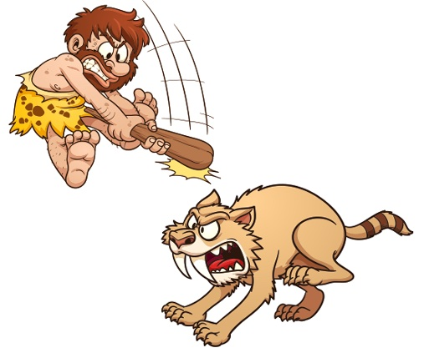
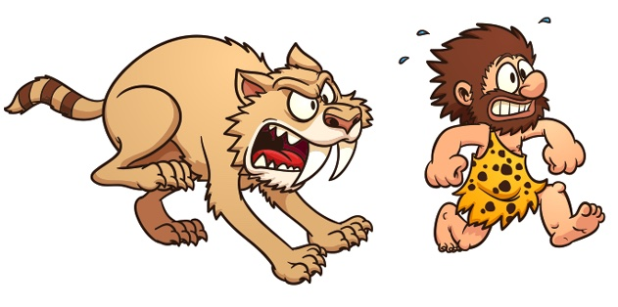
What is Stress?
Fight or Flight Response
Two types of Threats
External
Internal
Protects, Plan, Prepare
© This material remains the property of HSE Global

Slide 6
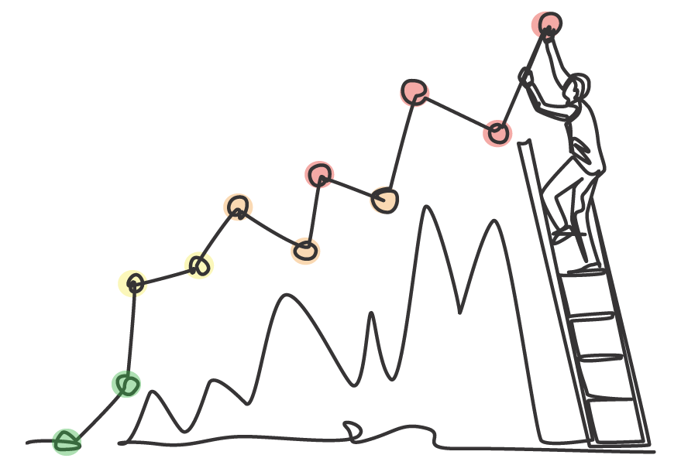
Impact of Chronic Stress
© This material remains the property of HSE Global

Slide 7
What is Burnout?
Overwhelming Exhaustion
Reduced Effectiveness
Cynicism & Detachment
Burnout is a psychological syndrome emerging as a prolonged response
to chronic psychosocial stressors on the job.
Notes:
The three key dimensions of this response are an
overwhelming exhaustion,
feelings of cynicism and detachment from the job,
and a sense of ineffectiveness and lack of accomplishment.
3 Major Elements of Burnout
Exhaustion
“Described [in the literature] as wearing out, loss of energy, depletion, debilitation, and fatigue,” the researchers write.
Cynicism
“Originally called depersonalization (given the nature of human services occupations), but…also described as negative or inappropriate attitudes towards clients, irritability, loss of idealism, and withdrawal.”
Inefficacy
A sense of not being as effective as one could be, was initially called “reduced personal accomplishment,” according to Maslach and Leiter. It’s come to be described as “reduced productivity or capability, low morale, and an inability to cope.”
Exhaustion and cynicism are the primary indicators and tend to reinforce each other. Together they frequently produce the sense of inefficacy.
Speaker’s Notes:
Wear and tear on the body caused by the need to adapt to changes or demands in the environment. Everyone has stress in their life. Not all stress is negative; in fact, stress is necessary in order to survive. We will talk about the impact of stress on performance in a moment.
Let’s use the analogy of a car to understand the impact of stress on our body. First there is acute stress, those immediate events that push the gas pedal of our bodies to rev us up and keep us on high alert. Most personal reactions to significant life events are normal and there are simple and effective strategies to help people deal with life stressors. It is a fact that most people deal effectively with the majority of stressors in their lives.
Then there is chronic stress – this involves those ongoing demands with no break – it is like a car that has been idling too long and running low on fuel, causing wear and tear on the vehicle. Research has indicated that chronic, unmanaged stress can be one factor in the development and/or exacerbation of a wide range of physical and mental health problems.
Ask:
So what causes stress?
The causes of stress are known as stressors. Stressors can be broken down into external stressors and internal stressors.
External Stressors include:
Major life events – These are those extraordinary events that occur in our life that put extra pressure on us. These can include positive events such things as marriage or the birth of a child; or negative events such as the death of a loved one, divorce, or exposure to a traumatic event.
Daily hassles – The majority of causes of stress that we face on a day-to-day basis are not as extreme as life events. The day-to-day causes of stress are called “daily hassles”; they are those daily, minor irritations such as misplacing our car keys, traffic jams, minor arguments with family/colleagues, etc. Research has found that it is the daily hassles rather than the major life events that affect us the most.
Internal Stressors include:
Stress reactions are highly individual because it is often not the demands placed upon people that cause the stress, but rather their interpretation that they are unable to cope with these demands. This means that stress is very unique for each person, as what is deemed to be overwhelming for one individual may not be for another as it is our own internal beliefs, attitudes, interpretations, perceptions and other factors, in combination with the external events, that tend to create stress.

Slide 8
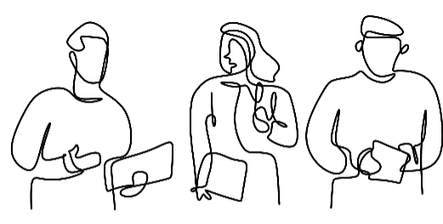
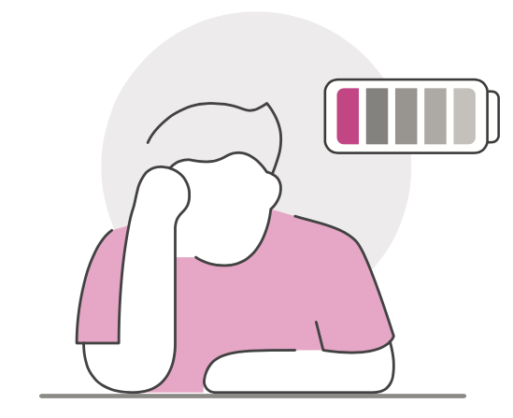
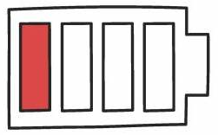
How Big a Problem is Burnout?
62%
Australian Workers reported being Burnout
40 %
5%
Of people that resigned stated burnout as the reason
Increase in burnout rates from 2021 to 2022
© This material remains the property of HSE Global

Slide 9
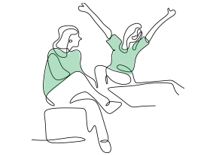
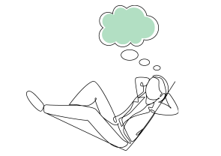
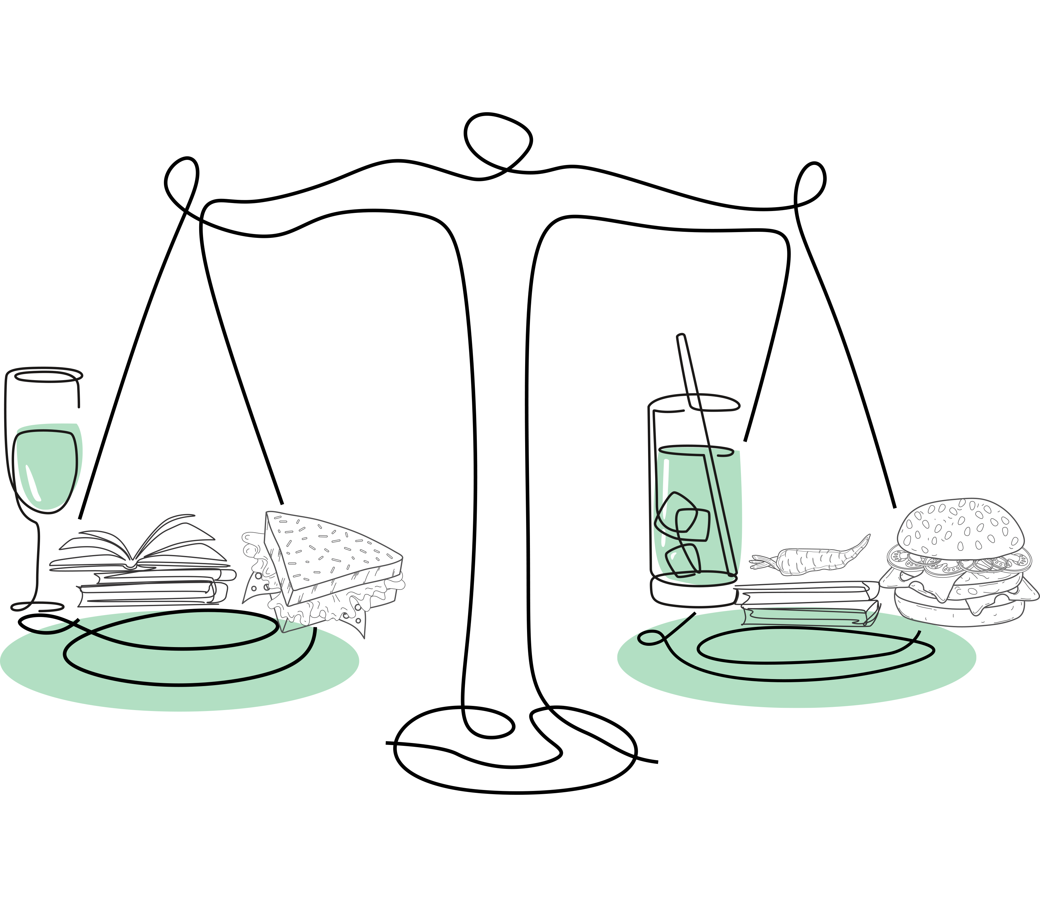
Mental Fitness Framework
Mood
Normal mood fluctuations Calm/confident | Irritable/impatient Nervous Sadness/overwhelmed | Anger Anxiety Pervasive sadness/hopeless | Easily enraged/aggression Excessive anxiety/panic attacks Depressed mood/numb
Good sense of humor Taking things in stride In control mentally Can concentrate/focus | Displaced sarcasm (occasionally “biting” or “lashing out”) Distracted/lose focus Intrusive thoughts | Negative attitude Recurrent intrusive thoughts Constantly distracted Can’t focus on tasks | Helpless/hopeless Cannot concentrate Loss of memory/cognitive ability Suicidal thoughts/intent
Normal sleep patterns Few sleep difficulties Physically well Feeling energetic Maintaining a stable weight | Trouble sleeping Lack of energy Changes in eating patterns Some weight gain or loss | Restless disturbed sleep Tiredness/fatigue Fluctuations in weight Major changes in eating patterns | Can’t fall asleep or stay asleep Sleeping too much or too little Physical illnesses Constant fatigue/exhaustion Extreme weight loss or gain
Physically and socially active Performing well | Decreased activity/socialising Procrastination | Avoidance Tardiness Decreased performance | Withdrawal Absenteeism Can’t perform duties/tasks
Limited alcohol consumption Limited/no unhelpful behaviours No trouble/impact (social, economic, legal, financial) due to behaviours | Regular to frequent alcohol consumption, limited binge drinking Some regular unhelpful behaviours Limited to some trouble/impact (social, economic, legal, financial) due to behaviours | Frequent alcohol consumption, binge drinking Struggle to control unhelpful behaviours Increasing trouble/impact (social, economic, legal, financial) due to behaviours | Regular to frequent binge drinking Addiction/extreme unhelpful behaviours Significant trouble/impact (social, economic, legal, financial) due to behaviours
Thinking/ Attitude
Physical
Behaviours/
Performance
Coping
Behaviours
© This material remains the property of HSE Global

Slide 10
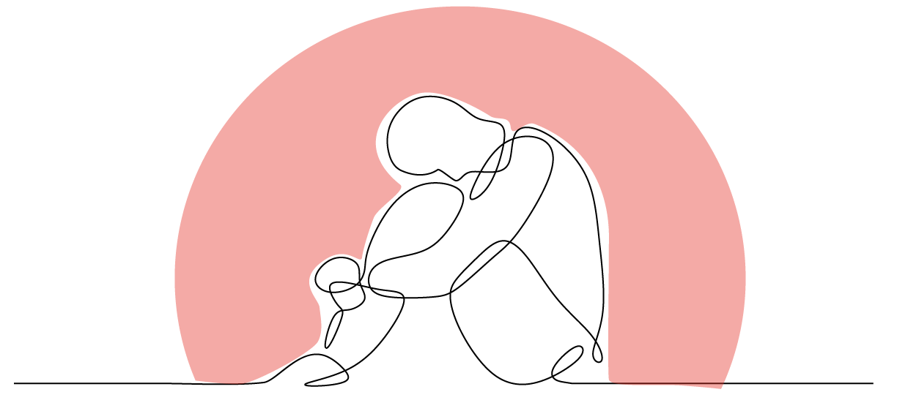
What causes Burnout?

Slide 11
What causes Burnout?
Notes:
Teams word cloud or menti metre activity
https://www.menti.com/al7e23szu634
Speaker’s Notes:
Wear and tear on the body caused by the need to adapt to changes or demands in the environment. Everyone has stress in their life. Not all stress is negative; in fact, stress is necessary in order to survive. We will talk about the impact of stress on performance in a moment.
Let’s use the analogy of a car to understand the impact of stress on our body. First there is acute stress, those immediate events that push the gas pedal of our bodies to rev us up and keep us on high alert. Most personal reactions to significant life events are normal and there are simple and effective strategies to help people deal with life stressors. It is a fact that most people deal effectively with the majority of stressors in their lives.
Then there is chronic stress – this involves those ongoing demands with no break – it is like a car that has been idling too long and running low on fuel, causing wear and tear on the vehicle. Research has indicated that chronic, unmanaged stress can be one factor in the development and/or exacerbation of a wide range of physical and mental health problems.
Ask:
So what causes stress?
The causes of stress are known as stressors. Stressors can be broken down into external stressors and internal stressors.
External Stressors include:
Major life events – These are those extraordinary events that occur in our life that put extra pressure on us. These can include positive events such things as marriage or the birth of a child; or negative events such as the death of a loved one, divorce, or exposure to a traumatic event.
Daily hassles – The majority of causes of stress that we face on a day-to-day basis are not as extreme as life events. The day-to-day causes of stress are called “daily hassles”; they are those daily, minor irritations such as misplacing our car keys, traffic jams, minor arguments with family/colleagues, etc. Research has found that it is the daily hassles rather than the major life events that affect us the most.
Internal Stressors include:
Stress reactions are highly individual because it is often not the demands placed upon people that cause the stress, but rather their interpretation that they are unable to cope with these demands. This means that stress is very unique for each person, as what is deemed to be overwhelming for one individual may not be for another as it is our own internal beliefs, attitudes, interpretations, perceptions and other factors, in combination with the external events, that tend to create stress.

Slide 12
Individual Factors
Age- Under 30
Low self evaluation
Blurred Work-Home boundaries
Obsessive
Passion
Sex- Female
Poor coping mechanisms
Personality
External Locus of Control
Parental
responsibilities
© This material remains the property of HSE Global
Notes:
High conscientiousness and perfectionism.
High introversion — especially introverted high achievers.
High agreeableness and hating conflict.Cant say no
Over-identifying with the job role.
Idealism, perhaps with unrealistic expectations.
Mindset- production paranoia- gotta be busy
Caring Professions- doctors, nurses, mental hleath professionals, HR, Mangers, Teachers, Vets etc
Age- under 30
https://www.bodyandsoul.com.au/mind-body/the-surprising-lifestyle-factors-putting-you-more-at-risk-to-burnout/news-story/226661ce907eb97f1cf48104538f851c
people who struggle with work/life balance are also at risk, as are those who have the mindset that working harder or longer will help. Those who have a hard time saying no or who regularly take on more than they can do well are in danger. One's workload feels and perceived lack of autonomy also factor in.
https://www.ncbi.nlm.nih.gov/pmc/articles/PMC4294456/#:~:text=Burnout%20occurs%20as%20a%20result,et%20al.%2C%202001).
Harmonious passion refers to an adaptive form of passion that is in harmony with one’s inner values and goals.
A harmoniously passionate worker:
Freely chooses to engage in their work, rather than feeling an uncontrollable urge to do so.
Loves their job and experiences sustained enjoyment and concentration from working each
day.
Is able to mentally “switch off” after work, and enjoy engaging in hobbies, sports, or spending time with family and friends.
Has a secure sense of who they are, what they want, and what they can achieve, and work does not overpower other areas of their life.
Harmonious passion is linked to positive affect, (hyper-focus), attention, organisational commitment, job satisfaction, life satisfaction, autonomous motivation, creativity and
performance, and lower levels of burnout, psychological distress and turnover intention.26
Obsessive passion refers an all-consuming form of passion that can result in conflict with other areas of someone’s life and is often dysfunctional.
An obsessively passionate worker:
Feels an uncontrollable urge to engage in their work.
Struggles to separate themselves from work, even though they may enjoy their job.
Might frequently bring work home with them, work late into the night, potentially to the point that it impacts their sleep.
May use work as a self-protective strategy or a source of pride, and as such;
May react defensively when criticized and when things go wrong.
These obsessive behaviours can take a toll on other aspects of the worker’s life. Relationships with family and friends may suffer, and they may struggle to find time for other hobbies or activities through which they can derive meaning.
While obsessive passion is linked to some valued workplace outcomes such as organisational commitment, a tendency to identify with the organisation, and citizenship (helping)

Slide 13
Workplace Causes - Psychosocial Hazards
High or low Job Demands
Poor
Workplace Relationships
Poor Support
Role
Team
Low Job
Control
Lack of Role Clarity
Harassment incl. Sexual Harassment
Bullying
Poor
Organisational
Justice
Poor
Environmental Conditions
Traumatic
Events or
Material
Organisation
Environment
Poorly Managed Change
Inadequate
Rewards &
Recognition
Remote or
Isolated work
Violence &
Aggression
© This material remains the property of HSE Global

Slide 14
Changing Regulations
WHS
Legislation
Commonwealth
Jurisdiction
1st April 2023
NT
1st July
2023
QLD
1st April 2023
WA
24th Dec 2022
SA
Proposed
Dec 2023
NSW
1st Oct 2022
ACT
29th August 2023
VIC
Draft Regulations
Proposed 2023
Current
1st October 2023
TAS
12th Dec 22
© This material remains the property of HSE Global

Slide 15
Beating Burnout
© This material remains the property of HSE Global

Slide 16
Beating Burnout
Individual
Leadership/
Team
Organisation
Individual
© This material remains the property of HSE Global

Slide 17
Beating Burnout

Slide 18
MHW Strategic Plan
Lead for Wellbeing
Engage & Identify
Control Risk
Support Pathways
Multiple Pathways of Support
Engage the Teams
Establish a Psychosocial Risk Profile for each Business Unit
Establish Competencies & Expectations
Identify or Develop Controls
Target High-Risk Roles
Train, Coach and Mentor
Integrate MHW KPI’s
Identify MH Champions
Identify & Assess Psychosocial Hazards
Review Control Effectiveness (e.g. EAP)
High Functioning Peer Support Network
Support for Leaders
Develop MHW Programs, Polices & Procedures
Mental Health Index Score
KPI’s in management development plans
Team/Site action plans in place
Hazard reporting rates
Program Participation Rates
Critical Control Plans in Place
Controls implemented to reduce Risk
RTW Success Rates
EAP, Peer Support Usage
Notes:
Benchmark Literacy

Slide 19
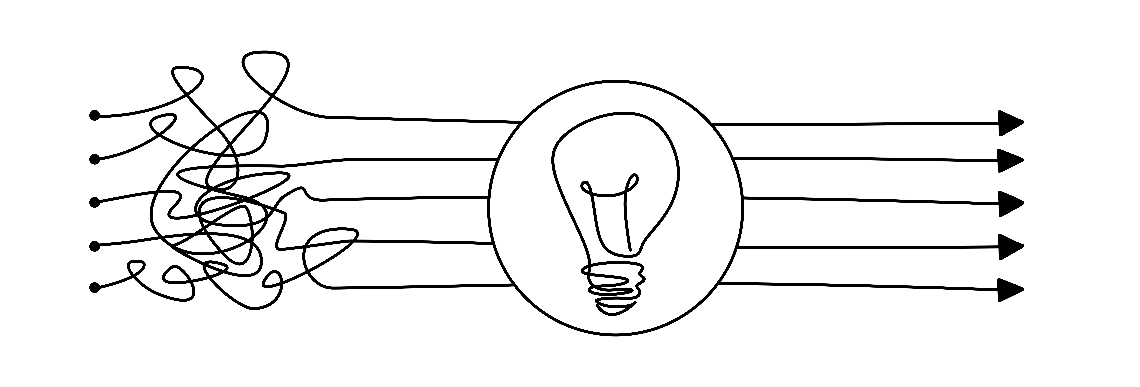
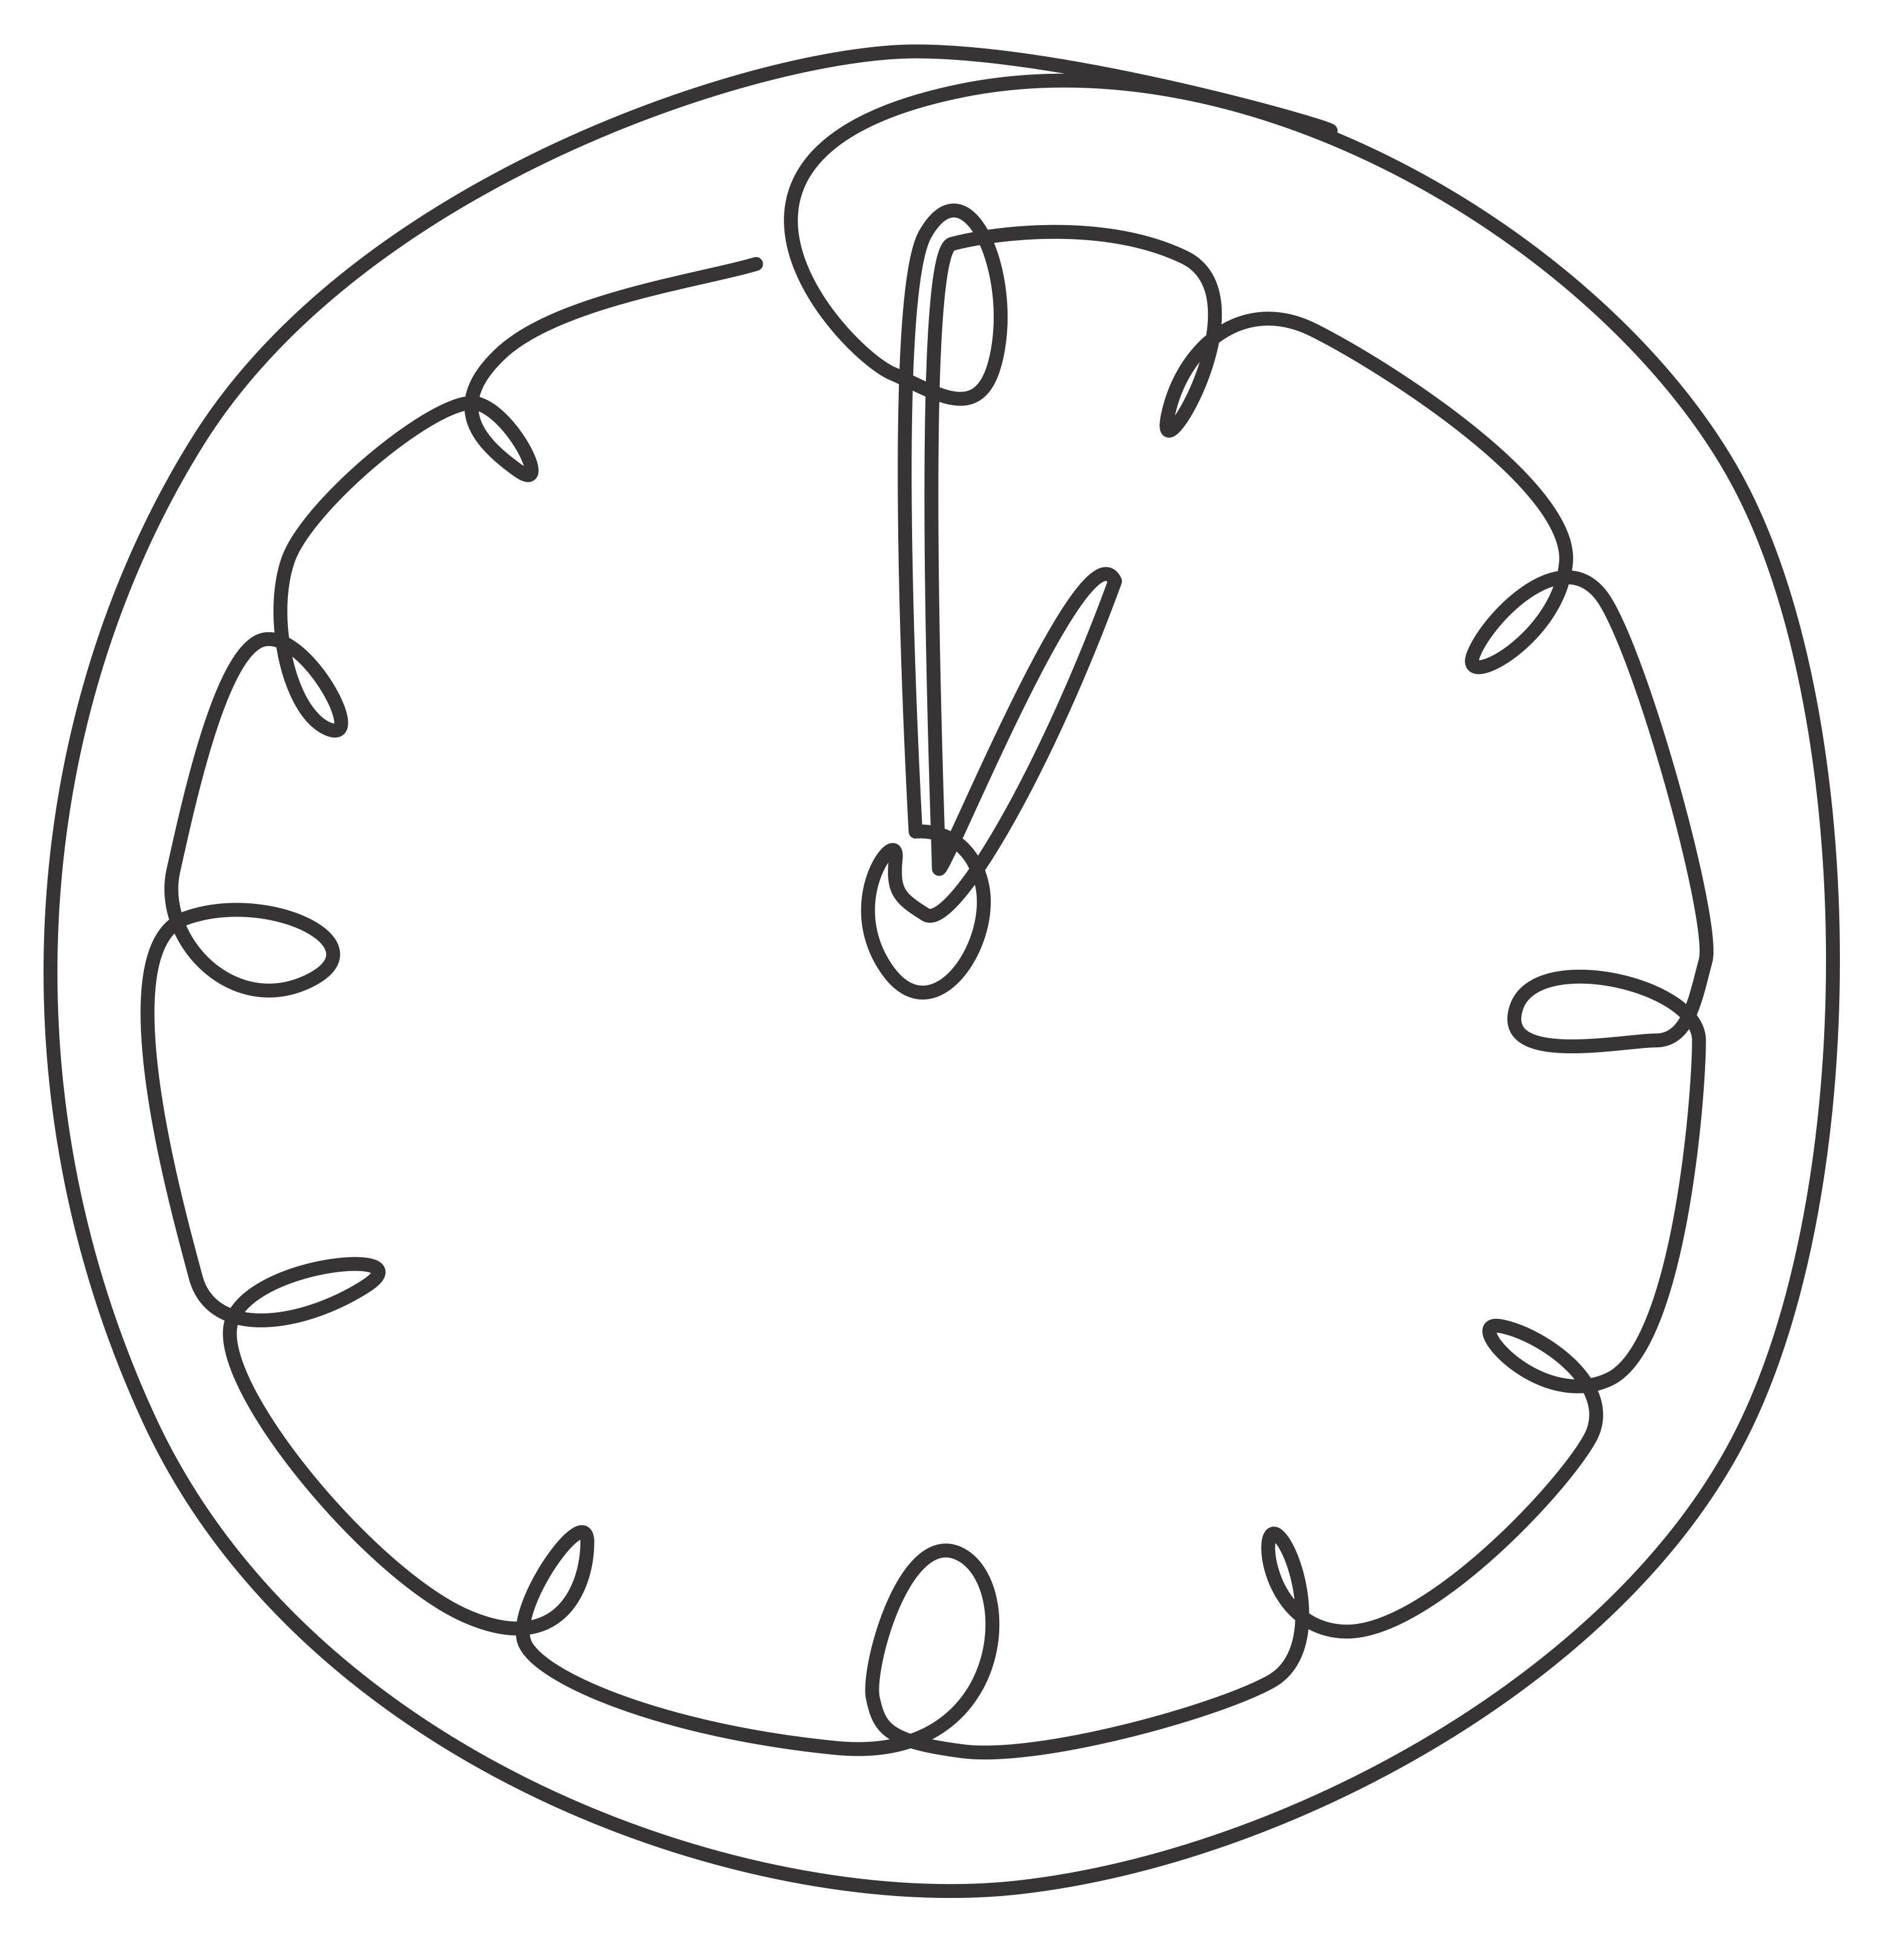
A Call to Action
As a result of today, what can you do differently to reduce the risk of burnout?
© All materials remain the property of HSE Global

Slide 20
Thank you
Notes:
Statement:
Acknowledge and thank participants and parent organisation for their time, honesty and commitment to mental fitness today.

