Slide 1
Looking after your Mental Health and Wellbeing over Christmas

Slide 2
What is your lead up to Christmas like?

Slide 3
Good mental health means we can:
Cope with normal stress
Realise our abilities
Learn and work well
Make decisions
Satisfying relationships
Contribute to community
Basically, enjoy life!

Slide 4
What can make Christmas hard?
Stress, social pressures, expectations of self or others
Financial stress
Loneliness
Grief, loss and sadness
Family interactions. Strained relationships
Change of routine

Slide 5
What helps?
Plan well Play well
Eat well Reflect well
Sleep well

Slide 6
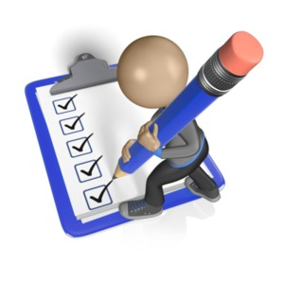
Plan well
Find ways to stay calm
Work out your priorities
Identify stress triggers
What can I do about it?
Set boundaries
What can I do about the triggers and stress?

Slide 7
Plan well
Manage family tensions
Avoid unrealistic expectations
Try to see other person’s stress
Consider “breaking up” warring groups
Try stress relief techniques – relaxation, distraction
Avoid too much alcohol – it will ignite any tensions

Slide 8
Identify stressful situations
Take breaks
Focus on the things that you enjoy
Ask for help with chores
Think before you commit
Give yourself permission to say No

Slide 9
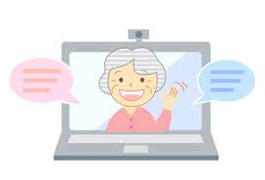
Plan well
Manage Loneliness
Use technology – phone, skype, FaceTime etc.
Make plans for Christmas before Christmas
Consider volunteering for charity
Invite someone – don’t wait for invitations
Check in with others who may be doing it tough, too

Slide 10
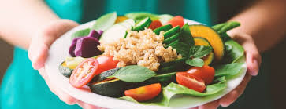
Eat Well (Most of the time)
Christmas is a time to enjoy company, treats, etc
Try and eat healthy
foods as well
Don’t forget to drink
plenty of water

Slide 11
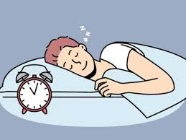
Sleep well
Aim for 7-8 hours each night
Keep your room cool
Ditch the IT

Slide 12
Play well
Have something simple to look forward to,
Laugh and enjoy small moments with family or friends
Exercise for at least 30 minutes a day, with others if possible
Spend time doing something you enjoy.

Slide 13
Get Active
Fitting in movement helps:
Relieve stress and anxiety
Boosts energy,
Works of those sweet treats
You feel better all round

Slide 14
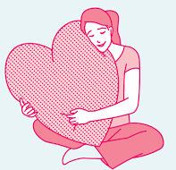
Be kind to yourself
Take time for yourself
Don’t let others rush you
Do things you enjoy as well
Watch your alcohol intake
Learn to say NO
Ask for help if you need it.

Slide 15
Spend some doing what you enjoy
Spending time with family and others is important
Spending time doing for others is important
But finding time for you is just as important

Slide 16
Reflect well
Spend some time in reflection, meditation,
Reflect on what has worked well for you during the year
Spend time in nature
Practice mindfulness
Live in the moment and have fun!
Be kind to yourself - Treat yourself with the same kindness and patience you would others
Ask for help if you need it.

Slide 17
Resources
Beyond Blue https://www.beyondblue.org.au/
Black dog Institute https://www.blackdoginstitute.org.au/
Lifeline Toolkit https://toolkit.lifeline.org.au/articles/support/beyond-blue-support-service
St John of God Healthcare https://www.sjog.org.au/

