Slide 1
PUBLIC GUARDIAN AND ESTATE MANAGEMENT DIVISIONS’
STAFF AND FILE MOVEMENTS
FOR LOCAL HEALTH DISTRICT TEAMS
Presentation to PSA 26 October 2026

Slide 2

Legislative appointments continue to grow, putting pressure on our organisation and staff
PG PRESSURE
PFM PRESSURE
DFM PRESSURE
153%
99%
22%
Increase in guardianship appointments over 10 years to June 2026
Increase in private financial manager appointments over 10 years to June 2026
Increase in direct financial manager appointments over 10 years to June 2026
(Net) Guardianship appointments increased by 629 matters from 4,773 to 5,402 from June 2025 to June 2026 (13.2% increase).
(Net) private financial manager appointments increased by 582 matters from 7,251 to 7,833 from June 2025 to June 2026 (8.0% increase).
(Net) direct financial manager appointments increased by 391 matters from 13,166 to 13,557 from June 2025 to June 2026 (3.0% increase).

Slide 3
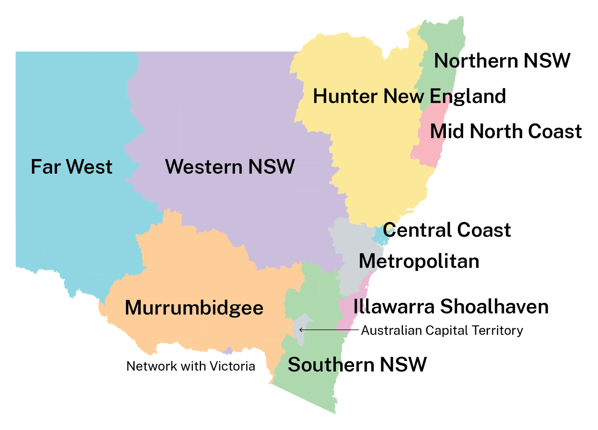
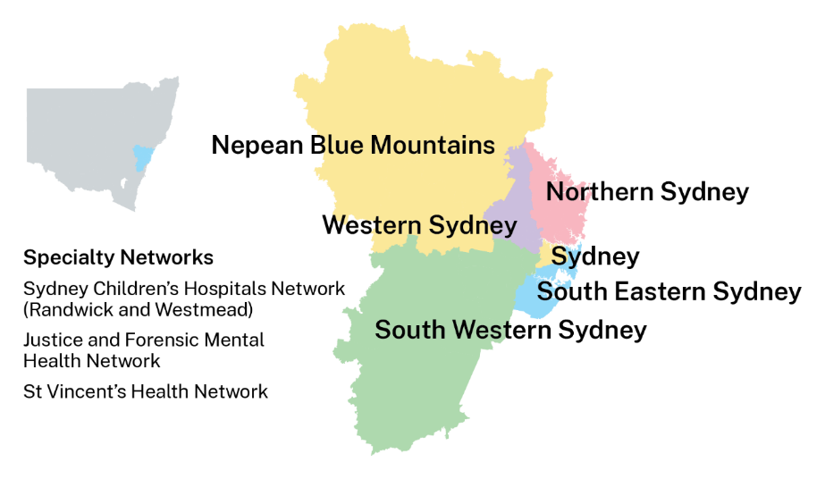
North
North
West
West
South
West
South

Slide 4
Aligned PG and EM future state portfolios
PNC MGR 9/10 Student Placements
PG and EM 11/12 portfolios are vertically paired to make geographic and functional alignment visible.
Manager Students
SOUTH AND ENGAGEMENT
Sydney, Wollongong, Albury
SOUTH WEST
Sydney, Liverpool, Campbelltown
WEST
Parramatta, Bathurst, Broken Hill
NORTH WEST
Newcastle, Lake Mac, Armidale
NORTH AND ESTABLISHMENT
Sydney, Gosford, Port Macquarie
PUBLIC
GUARDIAN
PG 11/12 • ASSISTANT PUBLIC GUARDIAN
PG 11/12 • ASSISTANT PUBLIC GUARDIAN
PG 11/12 • ASSISTANT PUBLIC GUARDIAN
PG 11/12 • ASSISTANT PUBLIC GUARDIAN
PG 11/12 • ASSISTANT PUBLIC GUARDIAN
PG Operations South
and Engagement
993 Files
PG Operations South West
1230 files
PG Operations West
1300 files
PG Operations North West
905 files
PG Operations North
and Establishment
1043 files +
Naomi Green
Tim O’Connor
New – TBC
Phil Kearton
Vicki Elliott
MGR 9/10 PG South 1 (485 files)
MGR 9/10 PG South West 1 (741 files)
MGR 9/10 PG West 1 (755 files)
MGR 9/10 PG North West 1 (452 files)
MGR 9/10 PG North 1 (433 files)
SES LHD (393) Other (92)
SWS LHD (741)
WS LHD (755)
HNE LHD including Newcastle and Lake Macquarie LGAs (452)
NS LHD (323) MNC LHD (110)
MGR 9/10 PG South 2 (508 files)
MGR 9/10 PG South West 2 (489 files)
MGR 9/10 PG West 2 (545 files)
MGR 9/10 PG North West 2 (453 files)
MGR 9/10 PG North 2 (410 files)
IS LHD (269) SNSW LHD (55) M LHD (184)
S LHD (489)
NBM LHD (215) WNSW LHD (314) FW LHD (16)
HNE LHD including rest of Hunter and New England LGAs (453)
CC LHD (231) NNSW LHD (179)
MGR 9/10 PG Stakeholder Engagement and Practice
MGR 9/10 PG South West 3 (XXX files)
MGR 9/10 PG West 3 (XXX files)
MGR 9/10 PG North West 3 (XXX files)
MGR 9/10 PG Establishment and Finalisation
SWS LHD (XXX)
WS LHD (XXX)
HNE LHD (XXX)
200+
EM 11/12 • SENIOR MANAGER
EM 11/12 • SENIOR MANAGER
EM 11/12 • SENIOR MANAGER
EM 11/12 • SENIOR MANAGER
EM 11/12 • SENIOR MANAGER
EM 11/12 • SENIOR MANAGER
EM Operations South
and Engagement
3133 Files +
EM Operations South West
2973 files
EM Operations West
3033 files
EM Operations North West
2240 files
EM Operations North and Establishment
2154 files
EM Operations Private Management
7833 files
ESTATE
MANAGEMENT
MGR 9/10 EM South 1 (1693 files)
MGR 9/10 EM South West 1 (1594 files)
MGR 9/10 EM West 1 (1773 files)
MGR 9/10 EM North West 1 (1120 files)
MGR 9/10 EM North 1 (1183 files)
MGR 9/10 EM Private Management 1
SES LHD (943) Other (750)
SWS LHD (1594)
WS LHD (1773)
HNE LHD including Hunter XXXX LGAs (1120)
NS LHD (879) MNC LHD (304)
2611 files
MGR 9/10 EM South 2 (1440 files)
MGR 9/10 PG South West 2 (489 files)
MGR 9/10 EM West 2 (1260 files)
MGR 9/10 EM North West 2 (1120 files)
MGR 9/10 EM North 2 (971 files)
MGR 9/10 EM Private Management 2
IS LHD (690) SNSW LHD (212) M LHD (538)
S LHD (1379)
NBM LHD (538) WNSW LHD (680) FW LHD (42)
HNE LHD including New England XXXX LGAs (1120)
CC LHD (488) NNSW LHD (483)
2611 files
MGR 9/10 EM Stakeholder Engagement and Practice
MGR 9/10 EM South West 3 (XXXX files)
MGR 9/10 EM West 3 (XXXX files)
MGR 9/10 EM North West 3 (XXXX files)
MGR 9/10 EM Establishment and Finalisation
MGR 9/10 EM Private Management 3
SWS LHD (XXXX)
WS LHD (XXXX)
HNE LHD (XXXX)
2611 files

